Slide 1
ITAC REVIEW
Hosted PaaS Implementation
RedHat OpenShift
Project PPM # 204119
Arun Kumar. S
04/2/2018
ITAC Presentation Template: Version Apr2017

Slide 2
Prior ITAC Presentations, Timelines, and Funding
Has project/proposal been previously reviewed at ITAC?
If yes, list below (replacing sample entries):
Type of ITAC approval requested for this presentation
Design Review
Anticipated Project Timelines
Current Phase of Project : Define
Estimated Implementation Date : 05 / 18 / 2018
Funding
Has Project Received AR Funding?: Yes
Initial AR target date: TBD
Additional AR target date (if relevant):
Type of Review | Date | Result (approved / not approved)
ITAC Presentation Template: Version Apr2017

Slide 3
Business Objective
Project Objective:
To build a PaaS capability on the Fifth Third Private Cloud Environment using RedHat OpenShift Product. This PaaS capability comprises of a Development, Testing, Staging, DR and Production environment accordingly to enable and support identified Container Adaption Roadmap. The Project will host identified application component on the PaaS Production environment, as part of the application hosting the project will determine required Cloud governance practices to support required container deployment patterns.
Reason Project Being Undertaken Now:
In order to enable application delivery teams to develop micro services based application, this project will enable the foundational capability to host Container technologies and Supporting services and Processes and will also onboard suitable applications on the platform with identified roadmap.
Anticipated Technical Outcome/Benefit (If Appropriate):
PaaS catalog for Fifth Third approved runtime and services
Environment to Build , Deploy and Promote application containers on demand
IT Policies or Standard deviations:
Secured Container Orchestration and Deployment Process
Docker image Portfolio Management (Service Portfolio Management)Process
Application Build and Deployment Process
ITAC Presentation Template: Version Apr2017

Slide 4
Technical Views
Container Adaption Roadmap
OpenShift PaaS : Release 1
Business Conceptual Design – PaaS : Release 1
Technical Overview
Network & Integration overview : Release 1
New Resource Requirements Summary
Delivery Pipeline overview : Release 1
OpenShift Capability Roadmap/Timeline
Business Conceptual Design – PaaS : Release 2 and further

Slide 5
OpenShift PaaS - Container Adaption Roadmap
May - 18
Sep- 18
3 Months
3 Months
Release 1 - Minimum Viable Product
Release 2 - Focused to improvise Product and Process Consumption
OpenShift Design
OpenShift Deployment
OpenShift Operations
OpenShift Integration
Container Security
Container Orchestration Process
Container Deployment Process
Release Management
Application Development
Release 1 : Host 1 Application as part of Platform build. Run through a complete Application life cycle for the identified application. Focus to build minimal required process around this app.
Release 2 : Onboard 10 to 15 more applications (mix of new and existing apps) on the platform and improvise product and process capabilities required to host these identified applications. Define blue print to support big bang migration for suitable existing applications
Release 3 : Leverage Foolproof Fifth Third Specific Process and Procedures to execute application migration for identified applications on the ramp up plan

Slide 6

OpenShift PaaS : Release 1
Release 1 : Host 1 Application as part of Platform build. Run through a complete Application life cycle for the identified application. Focus is to build minimal required process around this app.
“Alerts Engine Notifier ” will send Push Notifications to IOS devices based on the request from Alerts Engine.
Tier – 3
Alerts Engine Notifier App
Transactions Image
OpenShift Routing Layer
Alerts Engine
App Layer
Apple Push Notification
api.development.push.apple.com:443
api.push.apple.com:443
Libs A
Java 8
RHEL
OpenShift
RHEL OS
ESX Hypervisor
Hardware

Slide 7


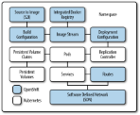
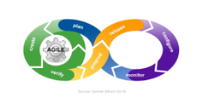


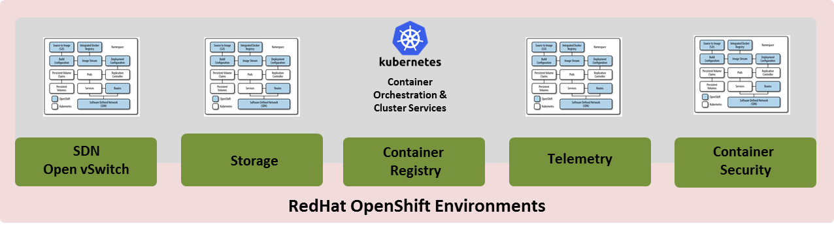
Business Conceptual Design – PaaS : Release 1
PaaS – Service Portfolio Management
Product / Application Owners
OpenShift Consumption
Layer
OpenShift (Dev)
Project Request
Approved
Submit Request for OpenShift
Dev Project (Namespace)
Workflow
Budget
Approval
Automated Provisioning of
OpenShift Project
(Namespace )
Product / Application Owners
Pre – Validated OpenShift Dev Project
Provisioned
Notify Project Details & Get Developer Access
Image Catalog / Repository
Automated
Security
Testing
Review
& Release
Approval
RedHat Supplied & Supported Docker Image’s
Build / Deploy in Dev
Devops Process for Container Promotions
Stage, Prod Project Provisioning - Promote to Stage & Prod

Slide 8


Technical overview
Grand Rapids
Florence
Prod / DR Environment
DEV / QA / STG Environment
Prod / DR Environment
Beta Environment
Management
NFS Mount
Management
NFS Mount
Management
NFS Mount
Management
NFS Mount
Master Nodes
Infra Nodes
App Nodes
Master Nodes
Infra Nodes
App Nodes
Master Nodes
Infra Nodes
App Nodes
Master Nodes
Infra Nodes
App Nodes
Vmware Virtualization Layer
Vmware Virtualization Layer
Private Cloud Prod Cluster
Private Cloud Prod Cluster
ITAC Presentation Template: Version Apr2017

Slide 9

Network & Integration overview : Release 1
Internal DNS
Proxy
Microsoft AD
/ Ping
Vault –
For Release 2
Tier – 3 N/W
Splunk
OpenShift Environment
OpenShift Management
Node
Router
OpenShift Masters
OpenShift Infra Nodes
OpenShift App Nodes
Image Registry
Public IP
OpenShift SDN Traffic
OpenShift Router Traffic
NFS Mount
ITAC Presentation Template: Version Apr2017

Slide 10
New Resource Requirements Summary
Device and Function | Device Type (Blade, VM, LPAR, etc.) | Qty | # of CPU | # of Gb of RAM | O/S Type (Windows, AIX, Solaris, etc.) & Version | SAN Non-Rep per Server | SAN Replicated per Server | Database (DB2, Oracle, SQL, etc.) & Versions | Environnent (Prod, Stage, DR, UAT, Dev, etc.) | Location (FloKY, GRaMI, etc.) | Middleware (IHS, IIS WAS, etc.)
Utility | VM | 1 | 4 | 32 | RHEL | 120 GB | N/A | N/A | Beta | Florence | N/A
Master | VM | 3 | 8 | 32 | RHEL | 290 GB | N/A | N/A | Beta | Florence | N/A
Infra | VM | 3 | 4 | 16 | RHEL | 420 GB | N/A | N/A | Beta | Florence | N/A
App | VM | 3 | 4 | 16 | RHEL | 470 GB | N/A | N/A | Beta | Florence | N/A
Utility | VM | 1 | 8 | 32 | RHEL | 120 GB | N/A | N/A | Dev | Grami | N/A
Master | VM | 3 | 8 | 32 | RHEL | 290 GB | N/A | N/A | Dev | Grami | N/A
Infra | VM | 3 | 4 | 16 | RHEL | 420 GB | N/A | N/A | Dev | Grami | N/A
App | VM | 6 | 8 | 32 | RHEL | 470 GB | N/A | N/A | Dev | Grami | N/A
Utility | VM | 1 | 4 | 16 | RHEL | 120 GB | N/A | N/A | Prod / DR | Florence | N/A
Master | VM | 3 | 8 | 32 | RHEL | 250 GB | N/A | N/A | Prod / DR | Florence | N/A
Infra | VM | 3 | 4 | 16 | RHEL | 400 GB | N/A | N/A | Prod / DR | Florence | N/A
App | VM | 4 | 8 | 32 | RHEL | 450 GB | N/A | N/A | Prod / DR | Florence | N/A
Utility | VM | 1 | 4 | 16 | RHEL | 120 GB | N/A | N/A | Prod / DR | Grami | N/A
Master | VM | 3 | 8 | 32 | RHEL | 250 GB | N/A | N/A | Prod / DR | Grami | N/A
Infra | VM | 3 | 4 | 16 | RHEL | 400 GB | N/A | N/A | Prod / DR | Grami | N/A
App | VM | 4 | 8 | 32 | RHEL | 450 GB | N/A | N/A | Prod / DR | Grami | N/A
ITAC Presentation Template: Version Apr2017

Slide 11
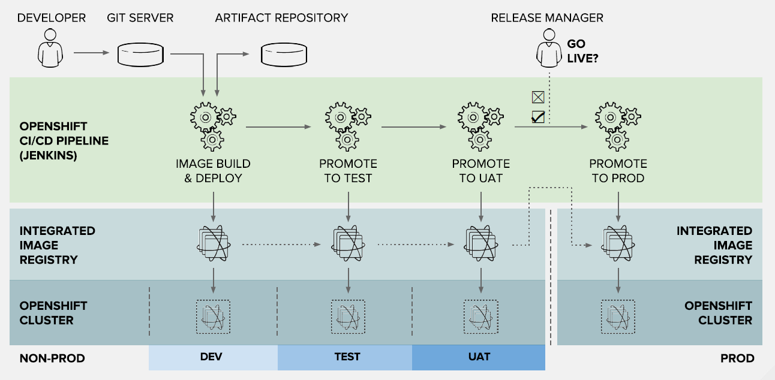
Delivery Pipeline General Overview for Release 1
ITAC Presentation Template: Version Apr2017

Slide 12
OpenShift Capability Roadmap/Timeline
Capability/Feature | Jun 2018 | Sep 2018 | Dec 2018 | 2019
JWS / Tomcat / Java | x | x | x | x
EAP |  | x | x | x
MQ replacement? |  |  | x | x
Internal Tier3 Network | x | x | x | x
DR Environment |  | x | x | x
DMZ Network |  |  | x | x
OpenShift in AWS |  |  |  | x
C, D rated apps | x | x | x | x
A, B rated apps |  | x | x | x
A+ rated apps |  |  | x | x
Build & Deployment Pipeline for JDK App’s | x | x | x | x
Build & Deployment Pipeline for EAP App’s |  | x | x | x
Host Docker Hub Images |  |  | x | x

Slide 13
Business Conceptual Design – PaaS : Release 2 and further
PaaS – Service Portfolio Management
OpenShift Governance, Engineering & Operations Layer
Product / Application Owners
OpenShift Consumption
Layer
Governance, Engineering &
Operations
OpenShift (Dev)
Project Request
Approved
Define , Approve &
Maintain
Service Request Form
Submit Request for OpenShift
Dev Project (Namespace)
Workflow
Budget
Approval
Automated Provisioning of
OpenShift Project
(Namespace )
Product / Application Owners
Pre – Validated OpenShift Dev Project
Provisioned
Consumer Feedback
Notify Project Details & Get Developer Access
Image Catalog / Repository
Automated
Security
Testing
Review
& Release
Approval
Define , Approve &
Maintain OpenShift
Service (Image) Catalog
RedHat Supplied & Supported Docker Image’s
Build / Deploy in Dev
Devops Process for Container Promotions
Define , Maintain &
Approve DevOps
Pipeline
Stage, Prod Project Provisioning - Promote to Stage & Prod
Define , Maintain Production readiness
Dashboard to support One Button
Release Approval process
Define , Maintain &
Approve OpenShift
Infra Standards
& Environments

Slide 14
Project Name, Project Sponsors, Key Members
Project Name: Hosted PaaS Implementation - RedHat OpenShift
Project Sponsors: Schnettler, Gary
Key Project Members: Mike Linville, Hedric Justin, Randall Gray, Brad Chamberlain/Joe Pizza, JP Srinivas, Stacey Johnston, Robert (Bob) Dove, Karen Carr, Michele McDonel, Ranbir Singh, Donald Knox, Dan Warren,
ITAC Presentation Template: Version Apr2017

Slide 15
IT Involvement To Date
List NPI Risk Rating: TBD
Enterprise Risk Advisor: TBD
Sourcing:
IT Risk Advisor:
IS Architect:
Solution Architect: Arun Kumar. S (FNU)
Enterprise Architect: Brant Comstock
DR & Business Continuity Planning: Darren, Sliwinski
Enterprise Data Management:
Shared Services: Karen, Carr
QA Testing : Eric, Tucker
IT Operations : Michele, McDonel
ITAC Presentation Template: Version Apr2017

Slide 16
Architecture Decisions
Subject Area | Business | Topic | Business Environment
Architecture Decision | To deploy OpenShift as the Platform as a Service for Fifth Third Application and Product Owners to consume
Problem statement & Requirements | Reduce Development and Operating Cost for Fifth Third Applications Suites Increase Speed of Development and Deployment for Fifth Third Application Suites Developers focus on rapid Development and Deployment Seamlessly promote or migration applications irrespective of the lower-level infrastructure
Assumptions | Cloud Security Framework needs to be elevated to accommodate Security policies for PaaS use cases New skills are required to enable and operate PaaS capability Cross skill matrix needs to be developed Enhance current IT governance controls to support PaaS consumption Current operations need to be extended to support initial PaaS workload on-boarding New operating Model and standards needs to be defined for matured PaaS enablement
Alternatives evaluated | Pivotal Cloud Foundry
Justification | PCF approaches each App service as a VM OpenShift helps to eliminate application dial tones such as “Config, Run time, Logs, Metrics, Health Management, Security and Operations” Leverages Native Docker container and Kubernetes orchestration technologies which has widespread commercial adoption
Implications
Derived Requirements (if any) | Governance, Operational Process, Users, Security
Related Decisions
ITAC Presentation Template: Version Apr2017

Slide 17
Architecture Decisions
Subject Area | Functional | Topic | Elasticity
Architecture Decision | Built in Service Discovery , Routers , SDN & Internal Load Balancing will be leveraged for service hosting
Problem statement & Requirements | Unable to adapt to workload / service changes by provisioning and de-provisioning resources in an autonomic manner
Assumptions | No management efforts required from SysOps to manage the SDN capability of OpenShift Developers will have API exposed to manage permissible Route and Network configuration for their services
Alternatives evaluated | Pivotal Cloud Foundry and VMware NSX
Justification | Elasticity is a mandatory characteristic that differentiates PaaS computing from traditional computing paradigms, such as grid computing.
Implications | Policies to be identified and defined to let the developers modify the network and route configuration for their services
Derived Requirements (if any)
Related Decisions
ITAC Presentation Template: Version Apr2017

Slide 18
Architecture Decisions
Subject Area | Functional | Topic | Base Image
Architecture Decision | Following are the Fifth Third approved container Images delivered and supported by RedHat available for developers to consume throughout Container Adaption Roadmap : Release – 1 Red Hat Container Development Kit by Red Hat, Inc. ; Red Hat Enterprise Linux by Red Hat, Inc. ; Red Hat JBoss Web Server by Red Hat, Inc.; Apache 2.4 with mod_perl/5.20; nginx 1.12 server and a reverse proxy server; Red Hat Developer Toolset toolchain ; Red Hat Developer Toolset perftools:Red Hat OpenJDK 8 image
Problem statement & Requirements | Containers allow a developer to package up an application with all of the parts it needs, such as libraries and other dependencies, and ship it all out as one package, base images are not available to build application services on top of OpenShift
Assumptions | RedHat will maintain, scan, sign and publish Image advisory for all of the images delivered and supported by them. E.g. https://access.redhat.com/containers/?tab=security#/registry.access.redhat.com/jboss-webserver-3/webserver31-tomcat7-openshift/images/1.1-8
Alternatives evaluated
Justification | Elasticity is a mandatory characteristic that differentiates PaaS computing from traditional computing paradigms, such as grid computing.
Implications | Fifth Third specific image Registry needs to be made available and corresponding process to pull RedHat supported Images needs to be defined
Derived Requirements (if any)
Related Decisions
ITAC Presentation Template: Version Apr2017

Slide 19
Architecture Decisions
Subject Area | Functional | Topic | Image Registry
Architecture Decision | For Release – 1 and Release – 2 the product will leverage internal built image registry to host supported Base Images and Application Images that’s being developed as part of Deployment Automation.
Problem statement & Requirements | Internal Image Registry is required to host Container images for OpenShift Developer consumption
Assumptions | By the end of Release – 2 Container Adaption Roadmap, We are expecting an Enterprise Repository will be identified and deployed , that will replace the internal Image registry service provided by OpenShift
Alternatives evaluated | Jfrog Repository Nexus
Justification | There is no enterprise Image registry service that is available for consumption
Implications | Migrate to JFROG enterprise once the later is available for general consumption
Derived Requirements (if any)
Related Decisions
ITAC Presentation Template: Version Apr2017

Slide 20
Architecture Decisions
Subject Area | Functional | Topic | Logging
Architecture Decision | OpenShift Platform will be integrated with Splunk to deliver and consume both OpenShift platform Logs and hosted Application service logs
Problem statement & Requirements | A log management solution is required to deliver OpenShift Platform logs and hosted application logs for operational and troubleshooting purposes
Assumptions | Required Licenses and operational procedure is available to deliver the log’s to Splunk and Consume the logs as needed
Alternatives evaluated | To leverage EFK logging solution available in OpenShift
Justification | Splunk is the Log Management tool that needs to be used as per Enterprise standards
Implications | Operational Procedures for OpenShift App log consumption needs to defined
Derived Requirements (if any)
Related Decisions
ITAC Presentation Template: Version Apr2017

Slide 21
Architecture Decisions
Subject Area | Functional | Topic | End User Interface
Architecture Decision | OpenShift CLI and API modules needs to be installed on Developers Desktop
Problem statement & Requirements | Developers need to have to have an User Interface to Work directly with project source code. Script OpenShift Container Platform operations.
Assumptions | Policies will be enabled to enforce RBAC for the end users, this ensures end users have operational capability within their project space Policies will be enabled to let the developers share their project space with other co – workers as needed.
Alternatives evaluated | OpenShift CDK Minishift OpenShift VM Image
Justification | Developers need access to the OpenShift Project space to execute Sys Ops functions as defined
Implications
Derived Requirements (if any)
Related Decisions
ITAC Presentation Template: Version Apr2017

Slide 22
Architecture Decisions
Subject Area | Functional | Topic | Deployment Automation
Architecture Decision | For Release – 1, Binary Deployment practice provided by OpenShift will be enabled and followed for which Jenkins hosted as a container will be leveraged, if Enterprise Jenkins is not available on time. For each consecutive builds a Deployment will be triggered for the specific environment
Problem statement & Requirements | OpenShift Provides three different way of Deployment practices to host the application services, it is recommended to identify the required deployment method that meets the application SDLC needs.
Assumptions | Devops Tools , Pipeline and supporting process will be made available to define the required tasks that supports binary deployment practice in OpenShift
Alternatives evaluated | S2I Build Docker Build
Justification | Though OpenShift provides build automation capability, as the Platform is new to Fifth Third at least for Release – 1 we recommend developers to follow their existing build practices which they are comfortable with. As the organization get matured on the Binary deployment process, post release – 2 and above they can start exploring other build and deployment automaton exhibited by OpenShift
Implications | Build and Deployment needs to created considering Container Deployment patterns Every Consecutive successful Builds will instantiate a deployment pipeline
Derived Requirements (if any)
Related Decisions
ITAC Presentation Template: Version Apr2017

Slide 23
Architecture Decisions
Subject Area | Functional | Topic | Monitoring
Architecture Decision | During Release – 1 and Release – 2, Native “EFK and Hawkular Cassandra “capability available on OpenShift will be leveraged for Metrics and Monitoring purposes
Problem statement & Requirements | Container Native Metric and Monitoring tools are required to enable operational support for the applications hosted on OpenShift
Assumptions | Before the end of release – 2 we are expecting a Enterprise Monitoring tool capable to deliver metrics and Alerts for container services will be made available
Alternatives evaluated | Site Scope
Justification | Site Scope - Site Scope doesn’t have native container integration capability Internal engineering efforts are required to build such integration capabilities
Implications | Need to identify a new Monitoring Product that delivers this demand
Derived Requirements (if any)
Related Decisions
ITAC Presentation Template: Version Apr2017

Slide 24
Architecture Decisions
Subject Area | Operation | Topic | Automation
Architecture Decision | Ansible Playbooks will be used to deploy and manage OpenShift Infrastructure for Release - 1 These Playbooks will be used as a module for Chef, once Chef Automation Server is available by Release – 2 and later
Problem statement & Requirements | OpenShift Infrastructure and Configuration needs to be maintained and operated
Assumptions | Chef will be made available by Release – 2 of Container Adaption program
Alternatives evaluated | Creating new Chef Recipes
Justification | RedHat delivers and supports Ansible playbooks to manage and operate these configurations
Implications
Derived Requirements (if any)
Related Decisions
ITAC Presentation Template: Version Apr2017

Slide 25
Architecture Decisions
Subject Area | Functional | Topic | DevOps Process
Architecture Decision | Devops Process required to Build, Deploy and Promote the Alerts Engine Notifier App across the environments to support Release – 1 will be identified and deployed. (CMDB, Configuration Item, Capacity Management, Change Management, etc.,.)
Problem statement & Requirements | Devops Process is required to consistently build develop and operate application services on OpenShift
Assumptions | All required support Devops tools will be made available
Alternatives evaluated | Manual Build, Deploy and Promote activities
Justification
Implications | Devops Pipeline needs to be reviewed with DevOps group to ensure organization approval
Derived Requirements (if any)
Related Decisions
ITAC Presentation Template: Version Apr2017

Slide 26
Architecture Decisions
Subject Area | Functional | Topic | DevOps Process
Architecture Decision | ITSM Process required to operate the Alerts Engine Notifier App will be identified and deployed.
Problem statement & Requirements | Existing ITSM process (CMDB, Configuration Item, Capacity Management )may not suit the need for Container technology
Assumptions | All required ITSM Process and techniques will be made available
Alternatives evaluated | Existing ITSM process such as Configuration Management, Change Management & Release Management
Justification
Implications | New CI needs to be created and Populated Process to manage the new CI types needs to be defined and agreed
Derived Requirements (if any)
Related Decisions
ITAC Presentation Template: Version Apr2017

Slide 27
Non Functional / operational Requirements
Capture all relevant operational requirements
Index | Requirement Name | Value(s)
NFR01 | Only pre-approved service offerings will be published in the service catalog
NFR02
NFR03
NFR04
NFR05
NFR06
ITAC Presentation Template: Version Apr2017

Slide 28
Checklist – Capacity Planning & Management
Item
Will long term transaction history require additional disk storage? | N/A
What are the product dependencies i.e. database - web presentation - Unix - Mainframe? | IDP / Authentication / Splunk / Monitoring /
Is it possible to monitor and record application resource utilization? | Y
What is the expected 1st year growth of the product? | As per the Roadmap
What is the means for storing archived data and how will data be restored? | N/A
Can the test environment be scaled down and still accomplish adequate testing? | Y
What resources are required for development? | Virtual servers
Is the current work load monitored today for vendor recommendation comparison? | N/A
Has the vendor produced performance statistics from a like sized environment if the product is new to our business? | Y
What are the product specifications for performance analysis on CPU, Memory, Disk and I/O utilization? | As listed on the Technical Design
Can the product function in a shared VMWare environment? | Yes
Is the product expandable/scalable up and down for business expansion and contraction? | Y
Does the solution uses / has any open source technologies (libraries, tools, platforms etc) | N
ITAC Presentation Template: Version Apr2017

Slide 29
Technology Stack - Automation
Cloud Provider
RedHat
ITAC Presentation Template: Version Apr2017

Slide 30
Maintenance & Support
Specify Initial and Ongoing Costs (Out to 3 Years)
Consulting
Hardware
Software
Outside Service Provider
Support
New or Existing FTEs? How many?
Existing
Required Skillsets?
RedHat OpenShift
Training
Training required on RedHat OpenShift
ITAC Presentation Template: Version Apr2017

Slide 31
Appendix

